Slide 1

CREDIT RISK SCORING – LOAN DEFAULT/RISK PREDICTION
2420030209 – Bhanu Prakash
2420030443 – Krishita Myneni
2420030002 – Laasya Priya

Slide 2
Reliability
Data Quality
Prediction
Efficiency
Problem Statement
Borrower data may contain missing, inconsistent, duplicate, and noisy records.
Poor-quality data can affect the accuracy of credit risk analysis.
How can we accurately assess and predict the credit risk of loan applicants using reliable borrower data?
Manual data inspection becomes time-consuming for large datasets.
A data-driven approach is needed to predict loan default risk and classify borrowers.

Slide 3
Motivation
Financial Loss
Data Quality
Automation
Risk Prediction
Decision Making
Centralization
Reduce potential losses caused by loan defaults.
Improve the reliability and consistency of borrower data.
Reduce manual data inspection and processing.
Use machine learning to identify borrowers likely to default.
Support more informed and efficient lending decisions.
Combine data quality analysis and credit risk prediction in one platform.

Slide 4
Objectives
Data Integration
Collect and combine loan-related data from CSV/Excel files, APIs, and web sources.
Data Preparation Clean the data by handling missing values, outliers, inconsistencies, duplicates, and noise.
Risk Prediction Develop and compare Logistic Regression, Random Forest, and XGBoost models to predict loan default risk.
Risk Classification Classify borrowers into Low, Medium, and High Risk categories based on predicted default probability.
Dashboard
Provide an interactive platform to visualize data quality, borrower characteristics, risk distribution, and model performance.

Slide 5
Expected Outcomes
Reliable Data — Generate clean and consistent borrower datasets with improved data quality.
Accurate Prediction — Predict loan default probability and identify important factors influencing credit risk.
Risk Assessment — Classify borrowers into Low, Medium, and High Risk categories using evaluated ML models.
Interactive Dashboard — Visualize data quality, risk distribution, borrower information, and model performance.

Slide 6
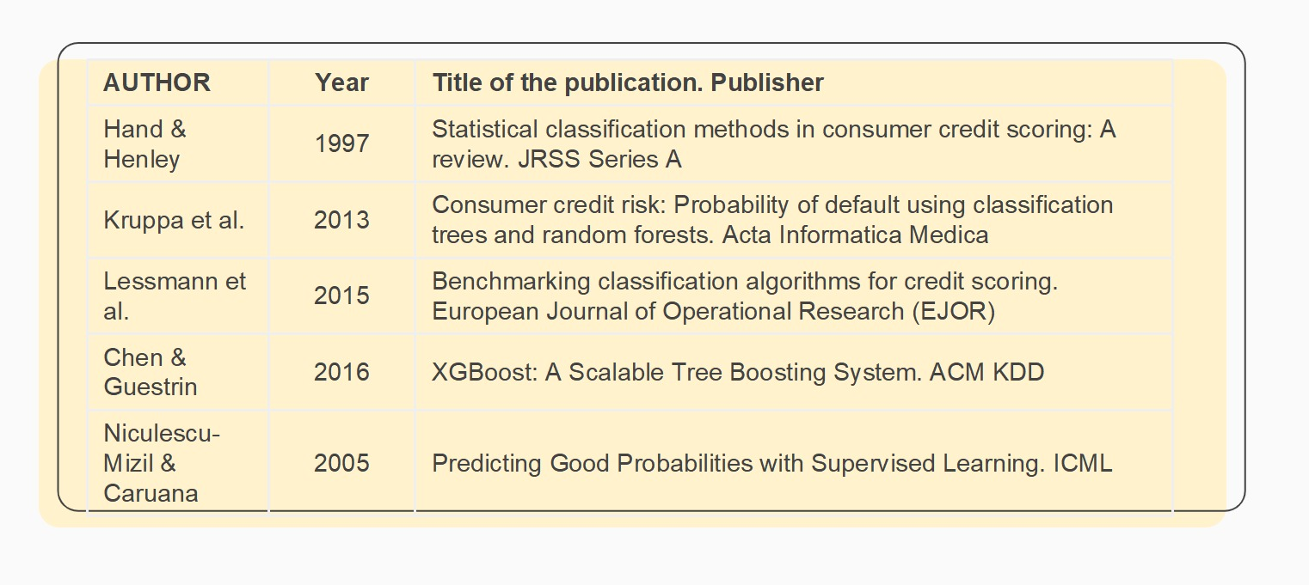
Literature Survey / Existing System

Slide 7
Limitations / Gaps
Limitations of Existing System
Research Gap
Manual data inspection can be time-consuming.
Poor-quality data can affect prediction reliability.
Duplicate and noisy records can affect analysis.
Data preprocessing and credit-risk prediction may be handled separately.
Existing approaches may not provide a centralized view of data quality and credit risk.
Need for an integrated system that combines:
Data Integration +
Data Cleaning +
Data Quality Assessment +
Duplicate Detection +
Machine Learning +
Risk Prediction +
Visualization

Slide 8
PROPOSED SYSTEM
An integrated pipeline for reliable credit-risk analysis and loan default prediction.
Data Sources
Data Integration
Data Preparation
Quality Assessment
CSV / Excel files,
APIs and web sources
ETL pipeline to collect
and combine loan data
Handle missing values,
outliers, duplicates and noise
Measure completeness,
consistency, validity and duplication
Feature Engineering
Risk Prediction
Risk & Dashboard
Use income, loan amount,
credit history, employment,
DTI and loan duration
Compare Logistic Regression,
Random Forest and XGBoost
Classify Low, Medium and High Risk;
visualize results and performance
Integrated data processing → machine learning → risk assessment → visualization

Slide 9
Thank you

